Slide 1
XML and Data Exchange
F21DF Database and Information Systems
Phil Bartie
Based on material from
Alasdair Gray
Kenneth McLeod

Slide 2

Materials released under CC-BY License
You are free to:
Share — copy and redistribute the material in any medium or format
Adapt — remix, transform, and build upon the material for any purpose, even commercially.
The licensor cannot revoke these freedoms as long as you follow the license terms.
Under the following terms:
Attribution — You must give appropriate credit, provide a link to the license, and indicate if changes were made. You may do so in any reasonable manner, but not in any way that suggests the licensor endorses you or your use.

Slide 3
This Lecture
Introduction to XML
What is XML used for?
Document Object Model (functions, properties)
XPATH
XSLT
DTD, XSchema

Slide 4
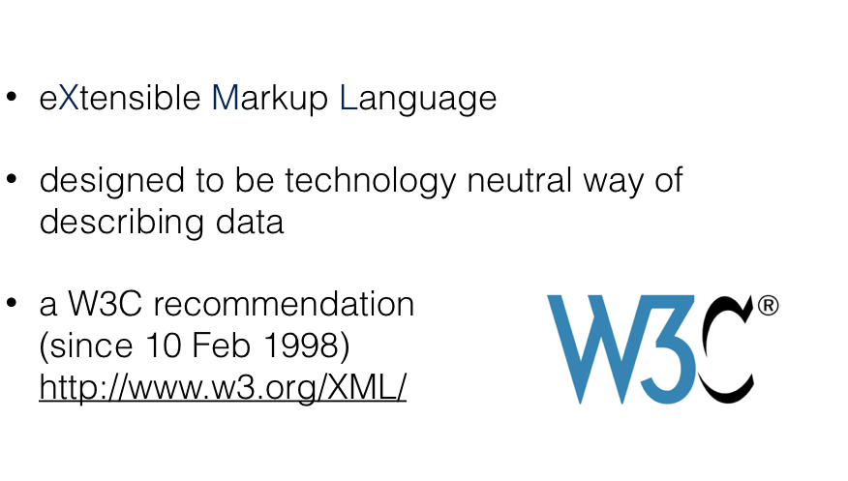
XML is ...
Notes:
XML is an eXtensible Markup Language
It uses tags like HTML however it’s not a replacement for HTML as it’s main goal is focussed on data description and transfer

Slide 5
XML is...
a markup language that defines a set of rules for encoding documents in a format that is both human-readable and machine-readable.
From wikipedia: https://en.wikipedia.org/wiki/XML
a metalanguage which allows users to define their own customized markup languages, especially in order to display documents on the Internet.
Notes:
The X is from eXtensible meaning that you can make up your own tags – we’ll look at this later

Slide 6
XML: Extensible Markup Language
<people>
<person>
<firstname>Bart</firstname>
<surname>Simpson</surname>
<tel>0131444777</tel>
<email>bart@example.com</email>
</person>
<person>
<firstname>Lisa</firstname>
<surname>Simpson</surname>
<email>lisa@macs.hw.ac.uk</email>
</person>
</people>
Notes:
Machine and human interpretable syntax
Semi-structured data model
Tags describe data content
Unknown/missing values omitted (eg Lisa - no tel #)
Captures structure of the data

Slide 7
XML Data Model
people
person pid=“33”
firstname
Bart
person pid=“34”
surname
Simpson
tel
01314447777
tel
0780116022
email
bart@example.com
firstname
Lisa
surname
email
Simpson
lisa@mac.hw.ac.uk
sister person=“34”
brother person=“33”
Notes:
Semi-structured
Tree traversal queries
Compare to relational modelling

Slide 8
XML Syntax
Root element
<?xml version="1.0" encoding="UTF-8" ?>
<people>
<person pid="33">
<firstname>Bart</firstname>
<surname>Simpson</surname>
<tel>0131444777</tel>
<tel>07840116022</tel>
<email>bart@example.com</email>
<sister person="34"/>
</person>
<person pid="34">
<firstname>Lisa</firstname>
<surname>Simpson</surname>
<email>lisa@macs.hw.ac.uk</email>
<brother person="33"/>
</person>
</people>
Attribute
Element
Nested elements
Repeated element
End tag omitted
<tel> omitted
Notes:
Annotated text file
One top-level root element
Case sensitive
Order sensitive - first item, last item etc

Slide 9
Element vs Attribute
Which is better?
Attribute
<person sex="female"> <firstname>Lisa</firstname> </person>
Element
<person>
<sex>female</sex> <firstname>Lisa</firstname> </person>
Notes:
Generally avoid using attributes unless
linking between XML records

Slide 10
Attributes are hard to maintain
Some of the problems with attributes are:
attributes cannot contain multiple values (child elements can)
attributes are not easily expandable (for future changes)
attributes cannot describe structures (child elements can)
attributes are more difficult to manipulate by program code
attribute values are not easy to test against a DTD
Notes:
Cannot have multiple values, but can have multiple ID, NMTOKENS, ENTITIES etc

Slide 11
Attribute or Element
Attribute
Element
IDs for cross-referencing
Nesting
Multiple occurrences
Extendable
Notes:
Elements support easier modification
Model as elements although IDs needed as attributes to support cross-referencing

Slide 12
Elements more easily expandable
If I start with this:
<person>
<first>Ken</first>
<last>McLeod</last>
</person>
<person>
<gender>male</gender>
<first>Ken</first>
<last>McLeod</last>
</person>
then later change to this:
my applications will be unaffected

Slide 13
ID and IDREF Attributes
<?xml version="1.0" encoding="UTF-8" ?>
<people>
<person pid="33">
<firstname>Bart</firstname>
<surname>Simpson</surname>
<tel>0131444777</tel>
<tel>07840116022</tel>
<email>bart@example.com</email>
<sister person="34"/>
</person>
<person pid="34">
<firstname>Lisa</firstname>
<surname>Simpson</surname>
<email>lisa@macs.hw.ac.uk</email>
<brother person="33"/>
</person>
</people>
Notes:
Cross referencing - useful to use
attributes like a Primary Key

Slide 14

Use Elements for data.
Attributes may be used for metadata.
Notes:
Attributes may also be useful for metadata

Slide 15
Well-formed Documents
An XML document is well-formed if
One top-level element
Tags are properly nested
Case sensitive
Attribute values enclosed in quotes
Attributes are not repeated

Slide 16
Elements: naming rules
Must start with a letter; cannot start with xml
Cannot contain white space, but may contain numbers, letters or punctuation
Best practice:
Make names descriptive: <first_name>
Avoid - . :

Slide 17
Syntax rules
Elements must be closed: </name>
Elements are case sensitive: <person></Person> WRONG!
Elements must be properly nested:
<a><b></a></b> WRONG!
Documents must have a single root element: <root><child><subchild>…</subchild></child></root>
Attributes must be in quotes: <person id="12345678">

Slide 18
<!-- a comment -->
< > & ‘ “ all have special codes:
&lt; &gt; &amp; &apos; &quot; e.g. <message>if salary &lt; 1000 then</message>
If all the rules are satisfied the document is well formed
Notes:
< is &lt; (less than) -- can't use < as it's part of the tag
etc for other 'special' characters....

Slide 19

Well formed ≠ Valid
To be valid, the XML document must match the data model described in the DTD or schema.
We want our XML documents to be both well formed AND valid.
Photo by rawpixel on Unsplash

Slide 20
Exercise - what is wrong?
<?xml version = "1.0" encoding = "UTF-8" ?>
<person phone = 0131-828-1234 >
<Name>
<first>Tim
<second>McMillan
</first></second>
</name>
Notes:
1) Inverted commas needed around the attribute (person phone = “0131-828-1234”)
2) <Name> … </name> --- case
3) </person> ..missing closing tag
4) <first> </first> tag needs to be opened and closed before opening the second

Slide 21
Exercise - what is wrong?
<?xml version = "1.0" encoding = "UTF-8" ?>
<person phone = "0131-828-1234" >
<Name>
<first>Tim
<second>McMillan
</first></second>
</name>
</person>

Slide 22
XML Editors
XML Specific
VisualStudio Code
XMLSpy
Eclipse
…
Code Editor with XML Mode/Highlighting
Atom
Emacs
Vim
Notepad++
GEdit
…

Slide 23
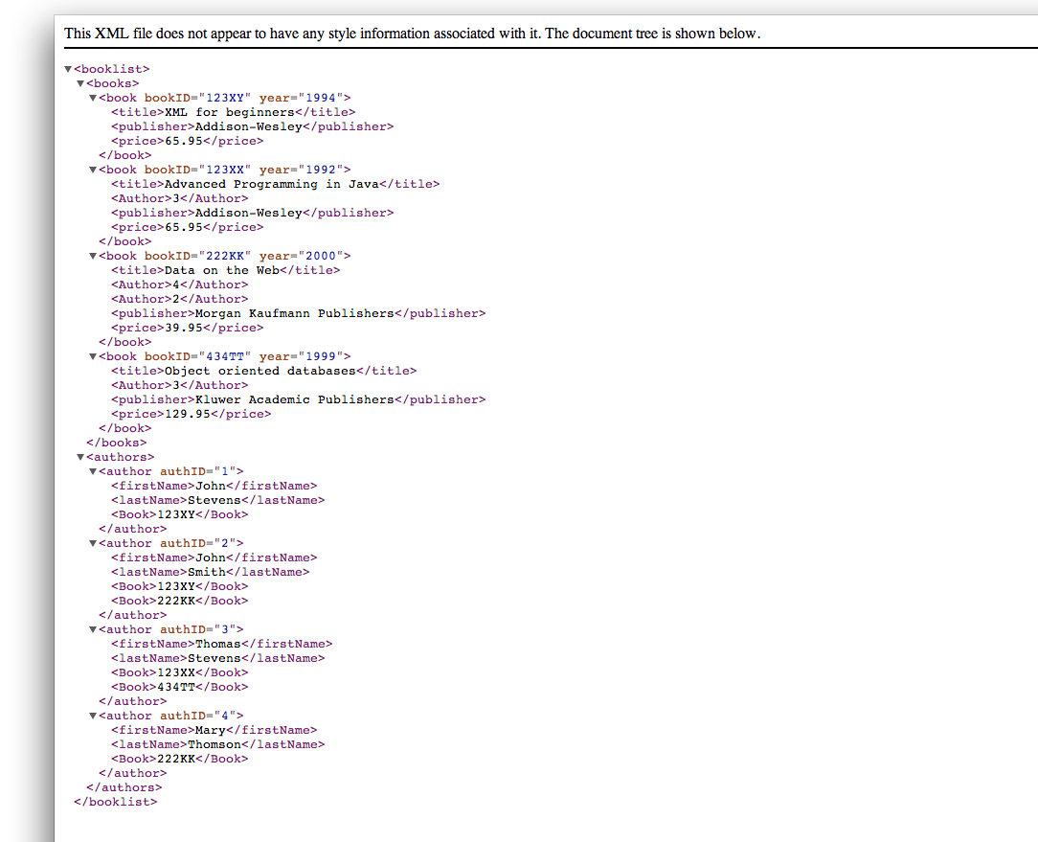
XML Viewers
Notes:
Many specific ones out there, but you can also use a web browser
-- demo the PERSON.XML
+ link to f21df lab example (albums)

Slide 24
Defining elements
Standard element definitions stored as DTD or Schema files
Try to reuse someone else’s definition before creating your own
Think about extending existing definitions if not suitable

Slide 25
Where is XML used
AJAX – asynchronous Javascript and XML
XHTML is HTML formatted as XML syntax
- almost identical to HTML but stricter
Web services – using APIs over the web
RSS / ATOM – used for publishing (e.g. news feeds)
e.g SOAP https://www.w3schools.com/xml/xml_soap.asp
https://www.w3schools.com/html/html_xhtml.asp
e.g. http://feeds.bbci.co.uk/news/rss.xml?edition=uk
http://feeds.bbci.co.uk/news/rss.xml?edition=int
Notes:
The X in AJAX is from XML -- used to pass data between client and server without having to reload the entire page – good for single page web apps (asynchronous data xfer – like Gmail)
XHTML – like a stricter HTML – tags must be closed (inc empty elements like <br /> ) , proper nesting, elements must be in lower case, attributes must be quoted (e.g. <table width="100%">)
Web services can use XML (not always) – e.g. SOAP (simple object access protocol)
{click on links for BBC RSS --- view source to see the XML -- next slide show example of that dataset}

Slide 26
RSS example (BBC news feed)
Viewing Source
Viewed using the XV Chrome Plugin
http://feeds.bbci.co.uk/news/rss.xml?edition=int#

Slide 27
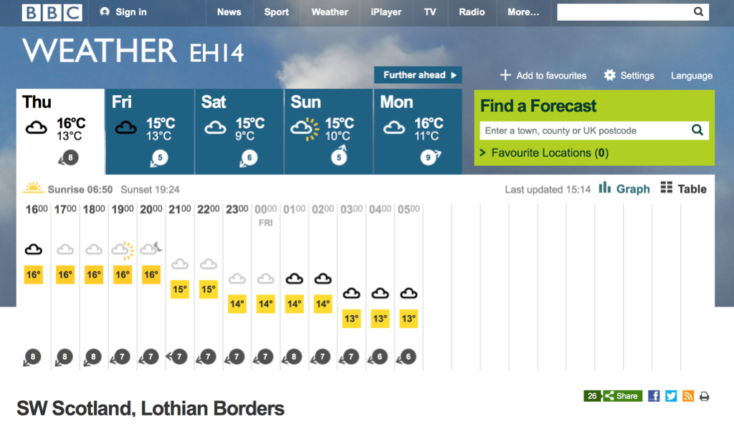
Example: publishing data
www.bbc.co.uk/weather

Slide 28
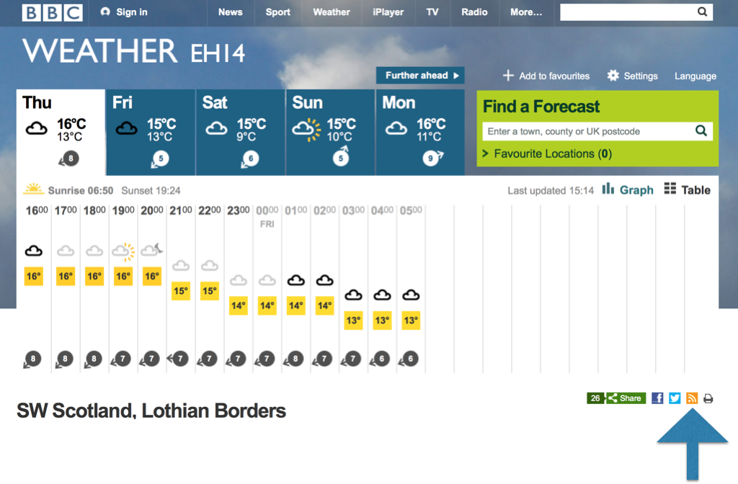

Slide 29
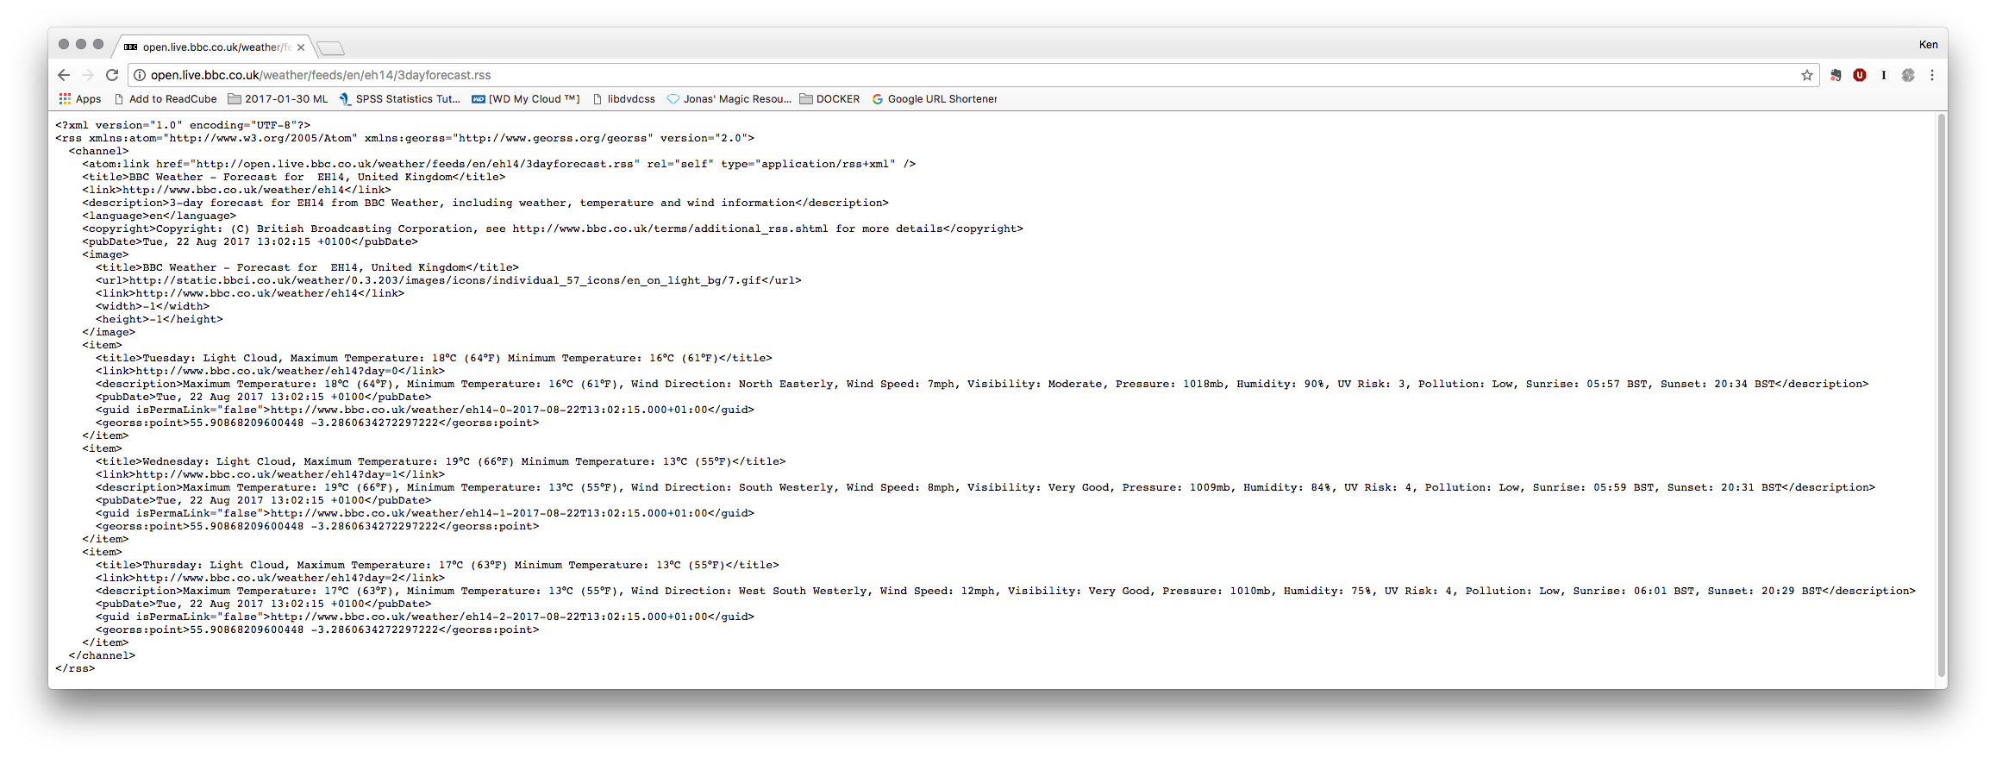
Publishing data via a web service… can be read by humans, but is really intended for computers
Notes:
Essentially an RSS feed… used for podcasts etc. Publishes...

Slide 30
XML vs CSV (Comma Separated Values)
CSV – comma separated values
- often used as an export/import format
- text file of values
- very simple
Header row
id,firstname,lastname,work phone, mobile phone, job title
1, bob, hills,0123-101,0789123,”surveyor”
2, alice, tall,0123-102,,”architect, towns and villages”
no value still needs entry (comma)
comma in the text – not parsed as data column
Considerations: If a column is missing or in the wrong order in the output CSV file then you may not know, while in XML data could be in any order as each data element is tagged XML supports nesting – ca
You can’t validate the CSV against a schema – XML does have method to check the document conforms to a specification
CSV are good if you have strict tabular data and know its structure in advance

Slide 31
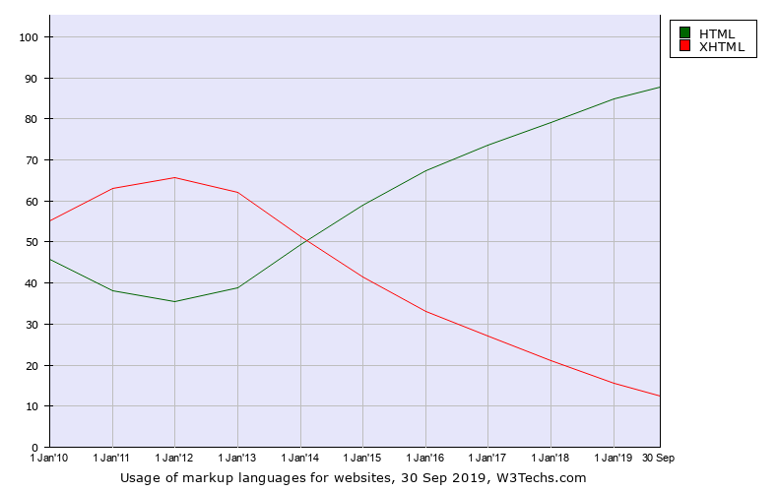
XHTML
XHTML was developed to:
Stricter standard for web pages – aiming to reduce incompatibilities between browsers
Extensible – so can define additional tags
Push the layout to CSS for presentation
Integration with Semantic Web
https://www.w3.org/TR/xhtml2/introduction.html
BUT.. HTML5 has better support in browsers, and more widely used
https://w3techs.com/technologies/history_overview/markup_language/ms/y
Notes:
Integration with the Semantic Web: make XHTML2 amenable for processing with semantic web tools.
XHTML – removes presentation aspects – like original HTML was focussed on representing document structure, and not its presentation.
HTML5 is compatible with more browsers than XHTML – ends up that HTML5 is more widely used

Slide 32
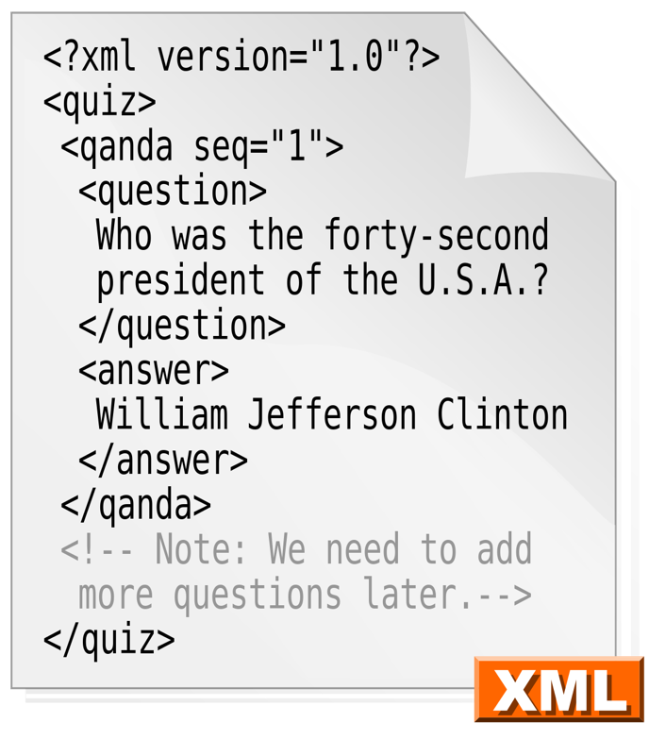

XML vs HTML
HTML is a presentation language, whereas XML is a data-description language.
HTML
Designed for presenting data
Bold: <b></b>
Paragraph: <p></p>
Predefined!
XML
Designed for describing data
Tags are not predefined…
You define your own
Notes:
So.. XML is really more about describing data.. Leave web page development to HTML5

Slide 33
Bob’s Database
Alice’s Database
mysql
Not mysql
Also transport to a new location?
Extract Transform Load
Extract data from Bob’s database
Transform data so it fits data model of Alice’s database
Load data into Alice’s database

Slide 34
Bob’s Database
Alice’s Database
mysql
Not mysql
Question:
What do we hold data in while transforming?
Notes:
Need a data format that can be used during the ETL….
XML can be used to transfer data between systems that were never designed to be used together.
For example 2 banking systems that need to swap some data.

Slide 35
Data Exchange
Used to transfer data between data systems
Three major file formats:
CSV: structured tabular data
XML: semi-structured, tagged data
JSON: semi-structured, tagged data

Slide 36
EXAMPLE ETL tool: etlhelper
etlhelper is a Python library to simplify data transfer between databases.
Postgres
Oracle
https://pypi.org/project/etlhelper/
Notes:
An example ETL tool… developed at British Geological Service (on HWU Edin campus)

Slide 37
Advantages of XML
Open format – used by applications like MS Office
Keeps content separate from the presentation
Can be used on server and client
Good support in many languages (e.g. Java, Python, .NET, JS)

Slide 38

In Office 2007 Microsoft changed its documents to use an XML based file type: Office Open XML
Try unzipping a .docx file and you will find a collection of .xml files

Slide 39
XML Storage
File System
XML Database
Relational Database
Blob
Shredded

Slide 40
XML Storage: File
Stored in file system
Text files
Edit using code editor
Programmatic access through standard libraries
XPath to extract data
<people>
<person>
<firstname>Bart</firstname>
<surname>Simpson</surname>
<tel>0131444777</tel>
<email>bart@example.com</email>
</person>
<person>
<firstname>Lisa</firstname>
<surname>Simpson</surname>
<email>lisa@macs.hw.ac.uk</email>
</person>
</people>

Slide 41



XML Storage: XML Database
XML Document store
Parses and indexes data
Separation of logical and physical models
Declarative query support
XPath
XQuery
Not widely used

Slide 42
XML Storage: RDBMS CLOB/Blob
<person>
<firstname>Bart</firstname>
<surname>Simpson</surname>
<tel>0131444777</tel>
<email>bart@example.com</email>
</person>
 |  | Document
 |  | <person> <firstname>Bart</firstname> <surname>Simpson</surname> <tel>0131444777</tel> <email>bart@example.com</email> </person>
Notes:
BLOB

Slide 43
XML Storage: RDBMS Shredded
<person>
<firstname>Bart</firstname>
<surname>Simpson</surname>
<tel>0131444777</tel>
<email>bart@example.com</email>
</person>
All major RDBMS support shredding
IBM DB2
Microsoft SQL Server
MySQL
Oracle Database
PostgreSQL
First | Last | Number | Email
Bart | Simpson | 0131444777 | bart@example.com
Notes:
Extracted and stored in tables

Slide 44
Disadvantages of XML
XML not suitable for very large data sets
XML is a text format, so not good for media (e.g. images, audio)
Can become hard to read (human) if very complex
Can become bloated compared to JSON, CSV
Generally slower to read/parse than CSV, JSON

Slide 45
XML related technologies [1]
XPath – eXtensible Path Language
- like the folder path for a file on a PC (/root/folder/sub-folder)
XQuery – like SQL for XML
- More advanced than Xpath - extract data from XML
XSLT – XML Stylesheet Language Transformations
- Stylesheet = how the dataset is displayed (a bit like CSS)
- Transformation= take XML and change to another type (e.g. PDF, text file, webpage, XML in different format)
Xpointer, XLink – links between and within XML documents
- like the link tag in HTML but more powerful
Notes:
We will go through Xpath, XSLT…
The lab also focusses on these

Slide 46
XML related technologies [2]
DTD – Document Type Definition
XSD – XML Schema document
Notes:
We will also cover DTD and XSD.

Slide 47
The Document Object Model (DOM) – HTML example
HTML
<html>
<head>
<title> Doc title here </title>
</head>
<body>
<p> Paragraph 1 here </p>
</body>
</html>
head
body
title
p
Doc title here
Paragraph1 here
HTML is the parent node
head / body are child nodes of HTML
head/ body are siblings of each other
title / p are child nodes of head/body respectively
Notes:
DOM represents the document as a TREE STRUCTURE

Slide 48
DOM Properties
Property | Description
nodeName | Name of the node (e.g. tag name)
nodeType | Type of node (e.g. element, comment, text)
nodeValue | Node’s value (varies depending on nodeType)
attributes | Only for Elements – array of attributes and values
parentNode | Get the parent of the node (null if no parent)
childNodes | Array of child nodes (empty if none)
firstChild, lastChild | References the first/last child of the node
previousSibling, nextSibiling | References the previous/next sibilant of the node
e.g.
https://www.w3schools.com/xml/books.xml
https://www.w3schools.com/xml/tryit.asp?filename=try_dom_nextsibling2
Notes:
Overview of some of the DOM properties available in XML document
{click next slide which shows the contents of the books.xml file -- then will show example of nextSibling}

Slide 49
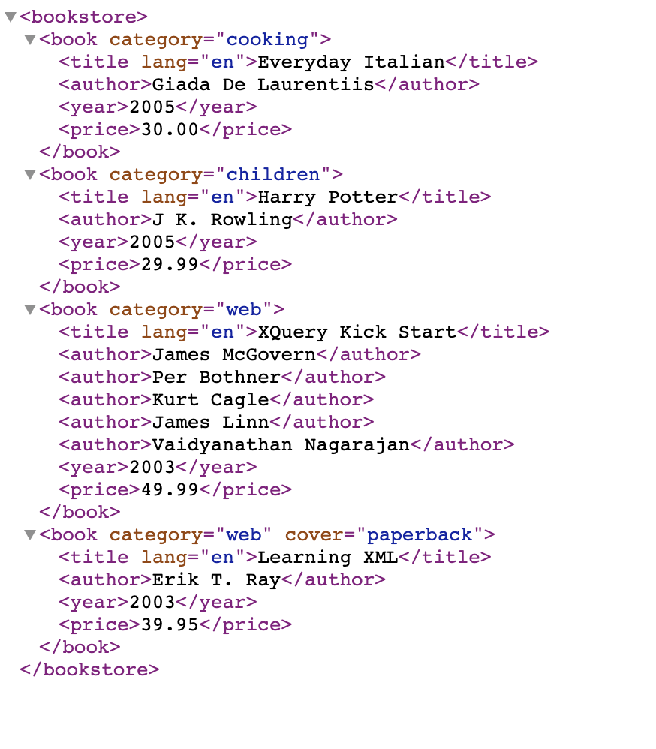
Demo of using nextSibling
https://www.w3schools.com/xml/tryit.asp?filename=try_dom_nextsibling2
https://www.w3schools.com/xml/books.xml
Notes:
{review the bookstore XML document}
{now click on demo link which uses this XML and shows next sibling detail in document tree – starts with top element and then shows the next sibiling}
--- ALTERNATE updated ver of the function to get next 2 siblings… hard coded… for title[1] -- can copy this to the web page and RUN it to see different output of 2 siblings shown
function myFunction(xml) {
var xmlDoc = xml.responseXML;
var x = xmlDoc.getElementsByTagName("title")[1];
var y1 = get_nextsibling(x);
var y2 = get_nextsibling(y1);
document.getElementById("demo").innerHTML = x.nodeName + " = " +
x.childNodes[0].nodeValue +
"<br>Next sibling: " + y1.nodeName + " = " +
y1.childNodes[0].nodeValue +
"<br>Next sibling: " + y2.nodeName + " = " +
y2.childNodes[0].nodeValue;
}

Slide 50
DOM Functions
Property | Description
appendChild() | Inserts element at the end of selected element’s children
removeChild() | Removes an element
insertBefore() | Inserts a new node before the given node
replaceChild() | Replaces node inside the parent with a new one
createElement() | Creates a new element to be inserted into the document
createTextNode() | Creates a new text node
createComment() | Creates a new comment
createCDATASection() | Creates a new CDATA section
getElementsByTagName() | Returns array of matching tags by name
getElementById() | Returns a single element with the given ID

Slide 51
DOM (continued)
Property | Description
getAttribute() | Get the value of a given attribute on an element
setAttribute() | Set the value of a given attribute on an element
removeAttribute() | Removes an attribute from an element
innerHTML | Gets / Sets HTML content of a tag
data | Gets the text data of an Element, Comment, Text node

Slide 52
XPath
W3C standard for accessing data from XML
Fundamental part of XSLT and XQuery

Slide 53
XPath Examples
/people/person/tel
Element='<tel>0131444777</tel>’ Element='<tel>07840116022</tel>'
people
person pid=“33”
firstname
Bart
person pid=“34”
surname
Simpson
tel
01314447777
tel
0780116022
email
bart@example.com
firstname
Lisa
surname
email
Simpson
lisa@mac.hw.ac.uk
sister person=“34”
brother person=“33”
/people/person/tel[1]
Element='<tel>0131444777</tel>'
/people/person/firstname
Element='<firstname>Bart</firstname>' Element='<firstname>Lisa</firstname>'
/people/person[2]/firstname
Element='<firstname>Lisa</firstname>'
//email
Element='<email>bart@example.com</email>' Element='<email>lisa@macs.hw.ac.uk</email>'
//people/person[ last() ]
Element='<person pid="34"> <firstname>Lisa</firstname> …. etc -- selects all of elements from last person in document
//people/person[@pid=”33”]
Element='<person pid="33"> <firstname>Bart</firstname> …..etc…. -- selects all of person matching attribute pid 33
//people/person[email="lisa@macs.hw.ac.uk" ]/firstname
Element='<firstname>Lisa</firstname>'
//people/person[email[contains(text(),"example")] ]/firstname
Element='<firstname>Bart</firstname>'
Notes:
Like exploring your file system… from console.. Navigating through the ‘location steps’
XPath is 1 based…so array index starts from 1 and not 0
// double slash means select the tag name wherever found in the document
text() gets the text of the current node
.. Means select the parent of the current node
Can use last() first() and attributes in selection
-- 2nd last example – select on email but show the firstname element value
--last example – use contains match

Slide 54
Other examples
/count(people/person/tel)
Int64='2'
<?xml version="1.0" encoding="UTF-8"?>
<people>
<person pid="33">
<firstname>Bart</firstname>
<surname>Simpson</surname>
<tel>0131444777</tel>
<tel>07840116022</tel>
<email>bart@example.com</email>
<sister person="34"/>
</person>
<person pid="34">
<firstname>Lisa</firstname>
<surname>Simpson</surname>
<email>lisa@macs.hw.ac.uk</email>
<brother person="33"/>
</person>
</people>
/people/person/count(tel)
Int64='2' Int64='0'
/people/person[@pid > 33]/firstname
Element='<firstname>Lisa</firstname>'
/people/person/(firstname | surname | email | ‘<br>’ )
Element='<firstname>Bart</firstname>' Element='<surname>Simpson</surname>' Element='<email>bart@example.com</email>' Element='<firstname>Lisa</firstname>' Element='<surname>Simpson</surname>' Element='<email>lisa@macs.hw.ac.uk</email>'
Notes:
Can COUNT all the records….
.. Or carry out the COUNT for elements in each record….
Use greater than, less than etc….
Also can do concatenation of elements using ( element1 | element2 | ... etc)

Slide 55
Try it out…
Google for Xpath tester…
e.g.
https://www.freeformatter.com/xpath-tester.html
/people/person/firstname
<?xml version="1.0" encoding="UTF-8" ?>
<people>
<person pid="33">
<firstname>Bart</firstname>
<surname>Simpson</surname>
<tel>0131444777</tel>
<tel>07840116022</tel>
<email>bart@example.com</email>
<sister person="34"/>
</person>
<person pid="34">
<firstname>Lisa</firstname>
<surname>Simpson</surname>
<email>lisa@macs.hw.ac.uk</email>
<brother person="33"/>
</person>
</people>
Element='<firstname>Bart</firstname>' Element='<firstname>Lisa</firstname>'

Slide 56
XSLT
Builds on Xpath
A bit like CSS but more focus on the Transformations than Stylesheets
Written using XML syntax
Very powerful – can export XML into PDF, Word, Text, another XML format
Can perform operations on the data (e.g. sorting)

Slide 57
Creating an XSLT Stylesheet
<xsl: stylesheet>
contains <xsl: template>
Templates are matched to XML tags
XML
RESULT
DOCUMENT
(e.g. PDF, XML)
XSLT
engine
XSLT
Notes:
The XSLT engine could be a browser.. Like firefox… (chrome can block due to safety settings)
Can run on the server
There are Open Source Processors like SAXON (http://saxon.sourceforge.net)

Slide 58
Common XSLT Elements
<xsl: stylesheet>
<xsl: template match = "xpath expression" >
<xsl: value-of select="xpath">
<xsl: attribute>
<xsl: text>
<xsl: for-each select="xpath">
<xsl: if test= "condition">
<xsl: choose>, <xsl: when>, <xsl: otherwise>
<xsl: sort select="">
Notes:
Like a programming language… e.g. choose is like CASE statement
The best way to understand XSLT is to look at some examples….

Slide 59
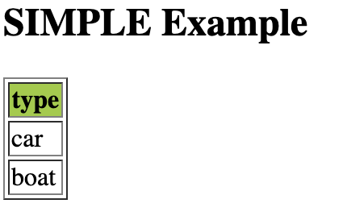
Example 1
XSLT FILE
<?xml version="1.0" encoding="ISO-8859-1"?>
<xsl:stylesheet version="1.0" xmlns:xsl="http://www.w3.org/1999/XSL/Transform">
<xsl:template match="/">
<html>
<body>
<h2>SIMPLE Example</h2>
<table border="1">
<tr bgcolor="#9acd32">
<th>type</th>
</tr>
<xsl:for-each select="catalog/item">
<tr>
<td>
<xsl:value-of select="type"/>
</td>
</tr>
</xsl:for-each>
</table>
</body>
</html>
</xsl:template>
</xsl:stylesheet>
XML DOCUMENT
<?xml version="1.0" encoding="ISO-8859-1"?>
<catalog>
<item>
<type>car</type>
</item>
<item>
<type>boat</type>
</item>
</catalog>
XML and XSLT:
https://www.freeformatter.com/xsl-transformer.html
Preview HTML output:
https://www.onlinehtmleditor.net
Notes:
Simple XML file… 2 items
XSLT – creates HTML table headers.. Then XSL FOR-EACH to loop over all catalog/item found in XML document
--- then uses XSL value-of to extract the type from the XML as a new HTML row
(Run live demo using the links and copy paste the text for XML and XSLT into the web browsers)

Slide 60
Example 2
XSLT FILE
<?xml version="1.0" encoding="ISO-8859-1"?>
<xsl:stylesheet version="1.0" xmlns:xsl="http://www.w3.org/1999/XSL/Transform">
<xsl:template match="/">
<html>
<body>
<h2>SIMPLE Example</h2>
<table border="1">
<tr bgcolor="#9acd32">
<th>item</th>
<th>type</th>
</tr>
<xsl:for-each select="catalog/item">
<tr>
<td> <xsl:number></xsl:number>
</td>
<td>
<xsl:value-of select="type"/>
</td>
</tr>
</xsl:for-each>
</table>
</body>
</html>
</xsl:template>
</xsl:stylesheet>
Use previous XML document
XML DOCUMENT
<?xml version="1.0" encoding="ISO-8859-1"?>
<catalog>
<item>
<type>car</type>
</item>
<item>
<type>boat</type>
</item>
</catalog>
<html>
<body>
<h2>SIMPLE Example</h2>
<table border="1">
<tr bgcolor="#9acd32"><th>item#</th> <th> type</th></tr>
<tr> <td>1</td> <td>car</td> </tr>
<tr> <td>2</td> <td>boat</td> </tr>
</table>
</body>
</html>
additional column
xsl:number
Notes:
XML doc the same but..
Now adding in xls:number element to determine the integer position of the current node in the source.
(see table output item#)

Slide 61
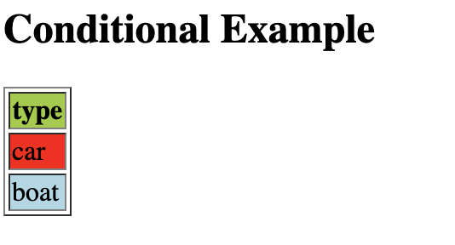
Example 3
XSLT
<?xml version="1.0" encoding="ISO-8859-1"?>
<xsl:stylesheet version="1.0" xmlns:xsl="http://www.w3.org/1999/XSL/Transform">
<xsl:template match="/">
<html>
<body>
<h2>Conditional Example</h2>
<table border="1">
<tr bgcolor="#9acd32">
<th>type</th>
</tr>
<xsl:for-each select="catalog/item">
<xsl:if test="colour='red'">
<tr bgcolor="red">
<td><xsl:value-of select="type"/></td>
</tr>
</xsl:if>
<xsl:if test="colour='blue'">
<tr bgcolor="lightblue">
<td><xsl:value-of select="type"/></td>
</tr>
</xsl:if>
</xsl:for-each>
</table>
</body>
</html>
</xsl:template>
</xsl:stylesheet>
XML DOCUMENT
<?xml version="1.0" encoding="ISO-8859-1"?>
<catalog>
<item>
<type>car</type>
<colour>red</colour>
</item>
<item>
<type>boat</type>
<colour>blue</colour>
</item>
</catalog>
Try it online:
https://www.w3schools.com/xml/tryxslt.asp?xmlfile=cdcatalog&xsltfile=cdcatalog_if
Notes:
This time added an extra element to the XML document for the item colour….
{click} And added to the XSL a conditional statement… if… which will filters on the colour element… and switches cell background colour depending on the element’s value.
{click} rendered result… red and light blue backgrounds according to the XML colour element value

Slide 62
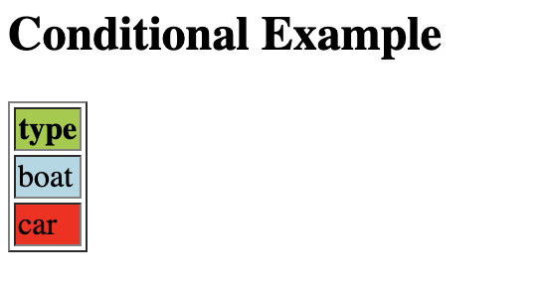
Example 4
XSLT
<?xml version="1.0" encoding="ISO-8859-1"?>
<xsl:stylesheet version="1.0" xmlns:xsl="http://www.w3.org/1999/XSL/Transform">
<xsl:template match="/">
<html>
<body>
<h2>Conditional Example</h2>
<table border="1">
<tr bgcolor="#9acd32">
<th>type</th>
</tr>
<xsl:for-each select="catalog/item">
<xsl:sort select="type"/> <xsl:if test="colour='red'">
<tr bgcolor="red">
<td><xsl:value-of select="type"/></td>
</tr>
</xsl:if>
<xsl:if test="colour='blue'">
<tr bgcolor="lightblue">
<td><xsl:value-of select="type"/></td>
</tr>
</xsl:if>
</xsl:for-each> </table>
</body>
</html>
</xsl:template>
</xsl:stylesheet>
Use previous XML document
(before)
SORTED
(now)
Try it online:
https://www.w3schools.com/xml/tryxslt.asp?xmlfile=cdcatalog&xsltfile=cdcatalog_if
Notes:
Same XML but now being sorted on TYPE element

Slide 63
Validating an XML document
DTD – Document Type Definition
XSchema
XSCHEMA
DTD
Two ways…
OLD WAY
NEW WAY

Slide 64
Workflow: XML vs DTD / Schema
2
DTD
<!DOCTYPE people
[
<!ELEMENT people (person+)>
<!ELEMENT person (name, gender?, email*)>
<!ELEMENT name (first, last)>
...
]>
XML Schema
<xs:element name="people">
<xs:complexType>
<xs:sequence>
<xs:element name="person" maxOccurs="unbounded">
<xs:complexType>
<xs:sequence>
<xs:element name="name">
<xs:complexType>
Create an instance of the syntax in XML
<?xml version="1.0" encoding="UTF-8" ?>
<!DOCTYPE people SYSTEM "people.dtd">
<people>
<person id="012345">
<name>
<first>Ken</first>
<last>McLeod</last>
</name>
<email>kcm1@hw.ac.uk</email>
</person>
</people>
Validate against DTD / Schema
1
3

Slide 65
XML DTD is used to...
Define standard (commonly used) elements
Provide a definition against which individual XML documents can be validated

Slide 66
XML DTD
DTD
XML instance
<!DOCTYPE people
[
<!ELEMENT people (person+)>
<!ELEMENT person (name, gender?, email*)>
<!ELEMENT name (first, last)>
<!ELEMENT first (#PCDATA)>
<!ELEMENT last (#PCDATA)>
<!ELEMENT gender (#PCDATA)>
<!ELEMENT email (#PCDATA)>
<!ATTLIST person id CDATA #REQUIRED>
]>
<?xml version="1.0" encoding="UTF-8" ?>
<!DOCTYPE people SYSTEM "people.dtd">
<people>
<person id="012345">
<name>
<first>Lisa</first>
<last>Simpson</last>
</name>
<email>ls123@hw.ac.uk</email>
</person>
</people>
Key
? = 0 or 1
* = 0 or more
+ = 1 or more
PCDATA = parsed character data
CDATA = (not parsed) character data
Help you interpret the DTD
Notes:
PCDATA - parsed character data
CDATA - character data (not parsed)
==> explained in more detail a few slides further on
{CLICK THRU NEXT FEW SLIDES TO EXPLAIN DTD}

Slide 67
XML DTD
<!DOCTYPE people
[
<!ELEMENT people (person+)>
<!ELEMENT person (name, gender?, email*)>
<!ELEMENT name (first, last)>
<!ELEMENT first (#PCDATA)>
<!ELEMENT last (#PCDATA)>
<!ELEMENT gender (#PCDATA)>
<!ELEMENT email (#PCDATA)>
<!ATTLIST person id CDATA #REQUIRED>
]>
<?xml version="1.0" encoding="UTF-8" ?>
<!DOCTYPE people SYSTEM "people.dtd">
<people>
<person id="012345">
<name>
<first>Ken</first>
<last>McLeod</last>
</name>
<email>kcm1@hw.ac.uk</email>
</person>
</people>
Key
? = 0 or 1
* = 0 or more
+ = 1 or more
PCDATA = parsed character data
CDATA = (not parsed) character data
If using separate files this links the XML to a DTD a file called people.dtd file

Slide 68
XML DTD
<!DOCTYPE people
[
<!ELEMENT people (person+)>
<!ELEMENT person (name, gender?, email*)>
<!ELEMENT name (first, last)>
<!ELEMENT first (#PCDATA)>
<!ELEMENT last (#PCDATA)>
<!ELEMENT gender (#PCDATA)>
<!ELEMENT email (#PCDATA)>
<!ATTLIST person id CDATA #REQUIRED>
]>
<?xml version="1.0" encoding="UTF-8" ?>
<!DOCTYPE people SYSTEM "people.dtd">
<people>
<person id="012345">
<name>
<first>Ken</first>
<last>McLeod</last>
</name>
<email>kcm1@hw.ac.uk</email>
</person>
</people>
Key
? = 0 or 1
* = 0 or more
+ = 1 or more
PCDATA = parsed character data
CDATA = (not parsed) character data
Root element called people; comprises at least 1 person

Slide 69
XML DTD
<!DOCTYPE people
[
<!ELEMENT people (person+)>
<!ELEMENT person (name, gender?, email*)>
<!ELEMENT name (first, last)>
<!ELEMENT first (#PCDATA)>
<!ELEMENT last (#PCDATA)>
<!ELEMENT gender (#PCDATA)>
<!ELEMENT email (#PCDATA)>
<!ATTLIST person id CDATA #REQUIRED>
]>
<?xml version="1.0" encoding="UTF-8" ?>
<!DOCTYPE people SYSTEM "people.dtd">
<people>
<person id="012345">
<name>
<first>Ken</first>
<last>McLeod</last>
</name>
<email>kcm1@hw.ac.uk</email>
</person>
</people>
Key
? = 0 or 1
* = 0 or more
+ = 1 or more
PCDATA = parsed character data
CDATA = (not parsed) character data
person contains a name,
may contain gender and,
an unknown number of email

Slide 70
XML DTD
<!DOCTYPE people
[
<!ELEMENT people (person+)>
<!ELEMENT person (name, gender?, email*)>
<!ELEMENT name (first, last)>
<!ELEMENT first (#PCDATA)>
<!ELEMENT last (#PCDATA)>
<!ELEMENT gender (#PCDATA)>
<!ELEMENT email (#PCDATA)>
<!ATTLIST person id CDATA #REQUIRED>
]>
<?xml version="1.0" encoding="UTF-8" ?>
<!DOCTYPE people SYSTEM "people.dtd">
<people>
<person id="012345">
<name>
<first>Ken</first>
<last>McLeod</last>
</name>
<email>kcm1@hw.ac.uk</email>
</person>
</people>
Key
? = 0 or 1
* = 0 or more
+ = 1 or more
PCDATA = parsed character data
CDATA = (not parsed) character data
name is comprised of 2 elements: first and last
first is of type PCDATA; the computer will read and interpret
whatever text is between the <first></first>

Slide 71
XML DTD
<!DOCTYPE people
[
<!ELEMENT people (person+)>
<!ELEMENT person (name, gender?, email*)>
<!ELEMENT name (first, last)>
<!ELEMENT first (#PCDATA)>
<!ELEMENT last (#PCDATA)>
<!ELEMENT gender (#PCDATA)>
<!ELEMENT email (#PCDATA)>
<!ATTLIST person id CDATA #REQUIRED>
]>
<?xml version="1.0" encoding="UTF-8" ?>
<!DOCTYPE people SYSTEM "people.dtd">
<people>
<person id="012345">
<name>
<first>Ken</first>
<last>McLeod</last>
</name>
<email>kcm1@hw.ac.uk</email>
</person>
</people>
Key
? = 0 or 1
* = 0 or more
+ = 1 or more
PCDATA = parsed character data
CDATA = (not parsed) character data
person has an attribute called id.
Attributes are specified after the elements.
id is of type CDATA, and the value will be ignored by the computer.

Slide 72
DTD & XML combined
<?xml version="1.0" encoding="UTF-8" ?>
<!DOCTYPE people
[
<!ELEMENT people (person+)>
<!ELEMENT person (name, gender?, email*)>
<!ELEMENT name (first, last)>
<!ELEMENT first (#PCDATA)>
<!ELEMENT last (#PCDATA)>
<!ELEMENT gender (#PCDATA)>
<!ELEMENT email (#PCDATA)>
<!ATTLIST person id CDATA #REQUIRED>
]>
<people>
<person id="012345">
<name>
<first>Lisa</first>
<last>Simpson</last>
</name>
<email>ls1@hw.ac.uk</email>
</person>
</people>
Notes:
You can combine the DTD and XML into
a single document rather than 2 files if
you wish

Slide 73
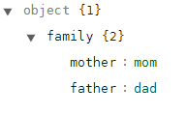
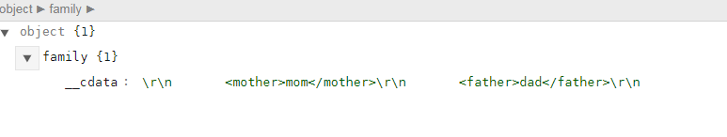
PCDATA vs CDATA
PCDATA is treated as markup
CDATA is text that will not be parsed
(by default everything is PCDATA)
<family>
<![CDATA[
<mother>mom</mother>
<father>dad</father>
]]>
</family>
<family>
<mother>mom</mother>
<father>dad</father>
</family>
Notes:
PCDATA – parsed character data. - the family element contains 2 more elements “mother” and ”father”.
- by default everything is PCDATA
CDATA – unparsed characted Data
- the value of family will be: <mother>mom</mother><father>dad</father>

Slide 74
Exercise - write a DTD for this
<?xml version="1.0" encoding="UTF-8"?>
<person>
<name>paul revere</name>
<profession>silversmith</profession>
<profession>engraver</profession>
<profession>early industrialist</profession>
<date_of_birth>1-1-1735</date_of_birth>
<date_of_death>10-5-1818</date_of_death>
</person>

Slide 75
Solution
<!DOCTYPE people
[
<!ELEMENT people (person+)>
<!ELEMENT person (name, profession+, date_of_birth, date_of_death)>
<!ELEMENT name (#PCDATA)>
<!ELEMENT profession (#PCDATA)>
<!ELEMENT date_of_birth (#PCDATA)>
<!ELEMENT date_of_date (#PCDATA)> ]>
Notes:
Specifying the elements and the kind of data each element holds

Slide 76

Common questions
DTD / Schema describe the data model?
Yes!
XML documents contain data that should correspond to the model?
Yes!
Why have DTD & Schema?
DTD is too simple & not written in XML.
Many legacy apps still use DTDs.
Photo by Bryan Minear on Unsplash

Slide 77
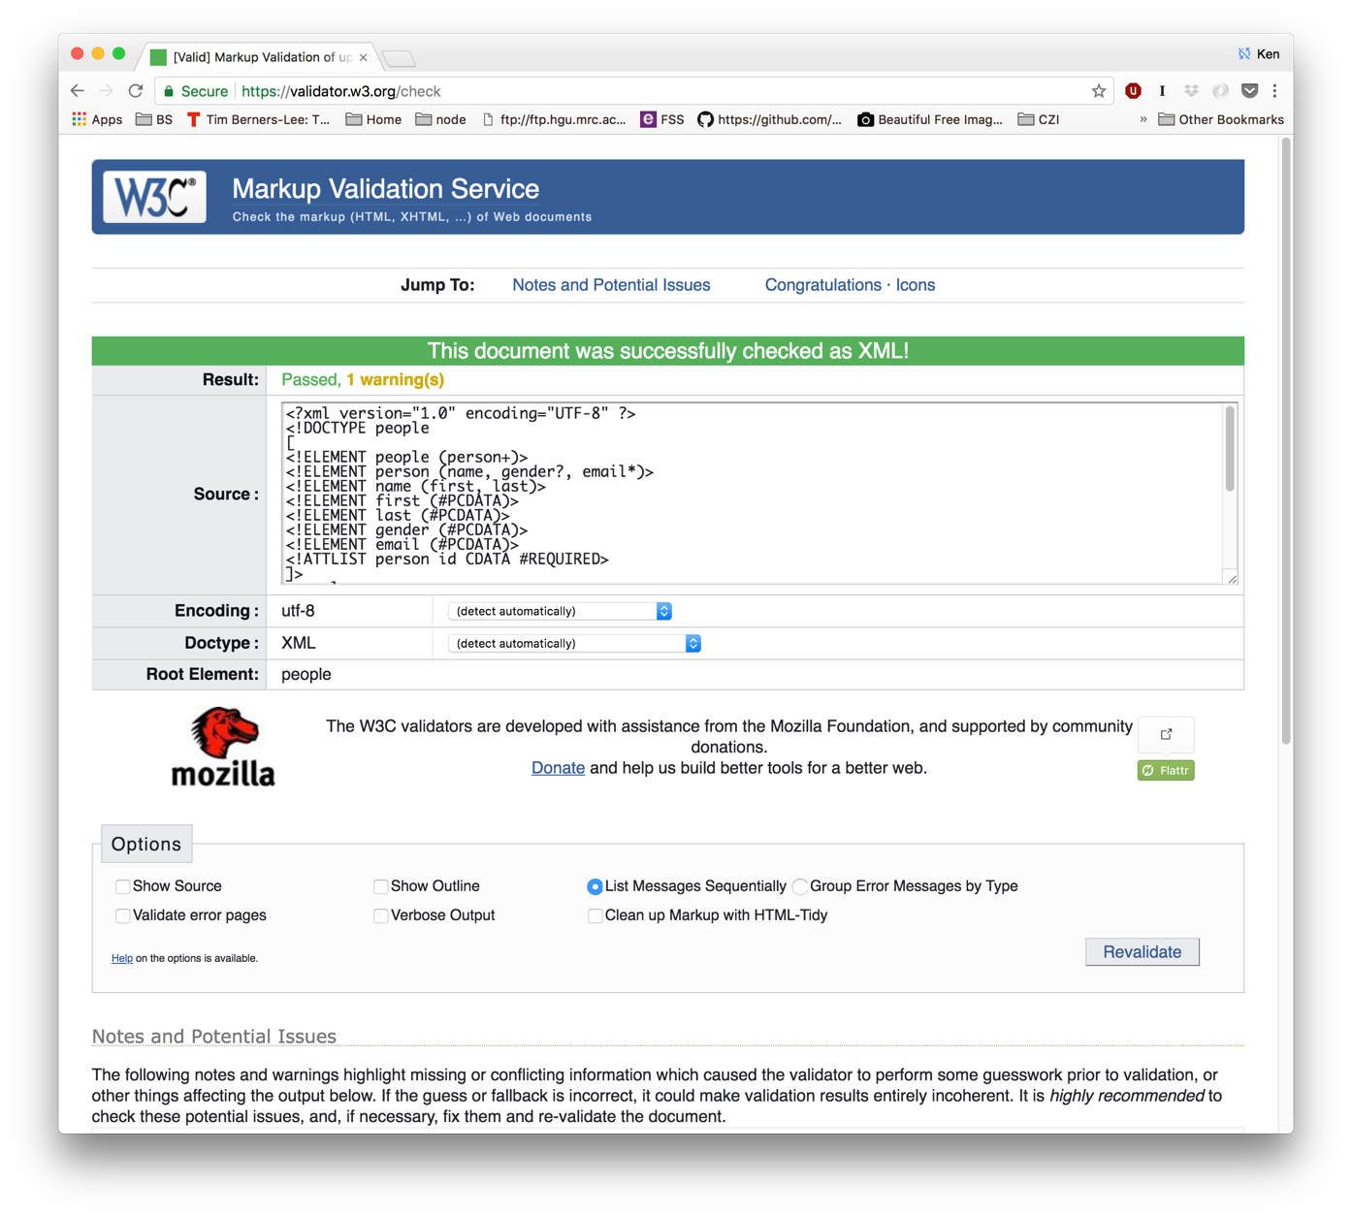
Validation... https://validator.w3.org

Slide 78
XSchema: XML Schema
W3C Standard: http://www.w3.org/XML/Schema
Primer
Structures
Datatypes
Component Designators
Versioning
Written in XML
Tutorial: http://www.w3schools.com/schema/

Slide 79
XSchema: XML Schema
Defined at http://www.w3.org/2001/XMLSchema
Built-in data types: Integers, string, date, …
Extensible with custom data types
Specification of constraints
Supports modularity and inheritence
Define a type and then use it by name
Build on other defined schemas

Slide 80
XML Schema
XML-based alternative to DTDs
More powerful, easier to extend
Includes data types, and better restrictions
Supports namespaces
WRITTEN IN XML!

Slide 81
XML Schema Header
<?xml version="1.0" encoding="UTF-8"?>
<xs:schema xmlns:xs="http://www.w3.org/2001/XMLSchema"
targetNamespace="http://www.macs.hw.ac.uk/dbis"
xmlns="http://www.macs.hw.ac.uk/dbis" >
xmlns:xs = imports terms from the official XMLSchema schema.
targetNamespace = defines the namespace that this schema is intended to target, or validate
xmlns = default namespace for this document. Any element that does not specify a namespace explicitly is deemed to use this one.
This is the top of the XML Schema document

Slide 82
XML Schema
<?xml version="1.0" encoding="UTF-8"?>
<xs:schema xmlns:xs="http://www.w3.org/2001/XMLSchema"
targetNamespace="http://www.macs.hw.ac.uk/dbis"
xmlns="http://www.macs.hw.ac.uk/dbis"
elementFormDefault="qualified">
<xs:element name="people">
<xs:complexType>
<xs:sequence>
<xs:element name="person" maxOccurs="unbounded">
<xs:complexType>
<xs:sequence>
<xs:element name="name">
<xs:complexType>
<xs:sequence>
<xs:element name="first" type="xs:string"/>
<xs:element name="last" type="xs:string"/>
</xs:sequence>
</xs:complexType>
</xs:element>
<xs:element name="gender" minOccurs="0"> ...
Root element is people
No limit on number of person elements
Default value of maxOccurs is 1
person contains other elements or attributes

Slide 83
<xs:element name="name">
<xs:complexType>
<xs:sequence>
<xs:element name="first" type="xs:string"/>
<xs:element name="last" type="xs:string"/>
</xs:sequence>
</xs:complexType>
</xs:element>
<xs:element name="gender" minOccurs="0"> ...
In a valid XML document <first> must come before <last> because they are a sequence

Slide 84
<xs:element name="name">
<xs:complexType>
<xs:sequence>
<xs:element name="first" type="xs:string"/>
<xs:element name="last" type="xs:string"/>
</xs:sequence>
</xs:complexType>
</xs:element>
<xs:element name="gender" minOccurs="0"> ...
A simple element <first> whose value is of type string.
Simple elements cannot have attributes!

Slide 85
<xs:element name="gender" minOccurs="0">
<xs:simpleType>
<xs:restriction base="xs:string">
<xs:enumeration value="male"/>
<xs:enumeration value="female"/>
</xs:restriction>
</xs:simpleType>
</xs:element>
gender may not be known; if it is known the value must be either ‘male’ or ‘female’.
So M or m are invalid!
maxOccurs is not specified because it defaults to 1

Slide 86
<xs:element name="age" minOccurs="0">
<xs:simpleType>
<xs:restriction base="xs:integer">
<xs:minInclusive value="1"/>
<xs:maxInclusive value="115"/>
</xs:restriction>
</xs:simpleType>
</xs:element>
age must be an integer between 1 and 115.

Slide 87
<xs:element name="people">
<xs:complexType>
<xs:sequence>
<xs:element name="person" maxOccurs="unbounded">
<xs:complexType>
<xs:sequence>
<xs:element name="name">
…
<xs:element name="age" minOccurs="0">
<xs:simpleType>
<xs:restriction base="xs:integer">
<xs:minInclusive value="1"/>
<xs:maxInclusive value="115"/>
</xs:restriction>
</xs:simpleType>
</xs:element>
</xs:sequence>
<xs:attribute name="id" type="xs:string" use="required"/>
</xs:complexType>
</xs:element>
</xs:sequence>
</xs:complexType>
</xs:element>
</xs:schema>
Attributes are specified last
You must define them after the </xs:sequence> but before the </xs:complexType>
Here we say person must have an id attribute

Slide 88
Other data types: xs:decimal, xs:boolean, xs:date, xs:time
Default value of minOccurs & maxOccurs is 1

Slide 89
Restrictions - enumeration
<xs:element name="car">
<xs:simpleType>
<xs:restriction base="xs:string">
<xs:enumeration value="Audi"/>
<xs:enumeration value="Golf"/>
<xs:enumeration value="BMW"/>
</xs:restriction>
</xs:simpleType>
</xs:element>
Car must be one of:
Audi
Golf
BMW
Document may contain something else, but it WILL NOT be valid.

Slide 90
Alternative gender restriction
<xs:element name="gender”>
<xs:simpleType>
<xs:restriction base="xs:string">
<xs:enumeration value="male"/>
<xs:enumeration value="female"/>
</xs:restriction>
</xs:simpleType>
</xs:element>
<xs:element name="gender">
<xs:simpleType>
<xs:restriction base="xs:string">
<xs:pattern value="male|female"/>
</xs:restriction>
</xs:simpleType>
</xs:element>
2 different ways of forcing valid documents to use ‘male’ or ‘female’ as value of gender.

Slide 91
Pattern based restrictions
<xs:element name="password">
<xs:simpleType>
<xs:restriction base="xs:string">
<xs:pattern value="[a-zA-Z0-9]{8}"/>
</xs:restriction>
</xs:simpleType>
</xs:element>
Passwords must be 8 characters long
Passwords may contain lowercase or uppercase letters and numbers.
No other characters are allowed. ¶^%¢£!

Slide 92
Restriction on length
<xs:element name="name">
<xs:simpleType>
<xs:restriction base="xs:string">
<xs:minLength value="5"/>
<xs:maxLength value="8"/>
</xs:restriction>
</xs:simpleType>
</xs:element>
name values must be between 5 and 8 characters long

Slide 93
Linking an XML document to a Schema
<?xml version="1.0" ?>
<people
xmlns="http://www.macs.hw.ac.uk/dbis"
xmlns:xsi="http://www.w3.org/2001/XMLSchema-instance"
xsi:schemaLocation="http://www.macs.hw.ac.uk/dbis http://www.macs.hw.ac.uk/~kcm/dbis/xmlSchema/people.xsd">
<person id="012345">
<name>
<first>Ken</first>
<last>McLeod</last>
</name>
<email>kcm1@hw.ac.uk</email>
</person>
</people>
Namespace Physical location of schema file
This is the XML instance document!

Slide 94
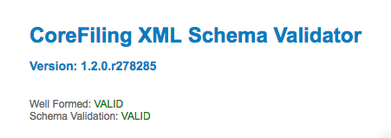
Validating XML against a Schema
https://www.corefiling.com/opensource/schemaValidate/

Slide 95
Additional Reading
https://www.w3schools.com/xml/xml_whatis.asp
https://www.w3schools.com/xml/xml_xpath.asp
https://www.w3schools.com/xml/xml_xslt.asp
https://www.w3schools.com/xml/xml_dtd.asp
https://www.w3schools.com/xml/xml_schema.asp

